Slide 1
DMS 201 : Introduction to Management Module-II: Financial Management Dr. Parvati Neelakantan

Slide 2
PART 1: BUSINESS ENVIRONMENT Lecture 10:Portfolio Theory and The Capital Asset Pricing Model

Slide 3
Topics Covered
Market Risk Is Measured by Beta.
The Relationship Between Risk and Return.
Does the C A P M Hold in the Real World?
3

Slide 4
Market Risk Is Measured by Beta
Market Portfolio: Portfolio of all assets in the economy. In practice, a broad stock market index such as the S&P Composite is used to represent the market.
Beta: Sensitivity of a stock’s return to the return on the market portfolio.
4

Slide 5
Portfolio Risk, Beta
Covariance between the stock i returns and the market returns.
Variance of the returns on the market.
5

Slide 6
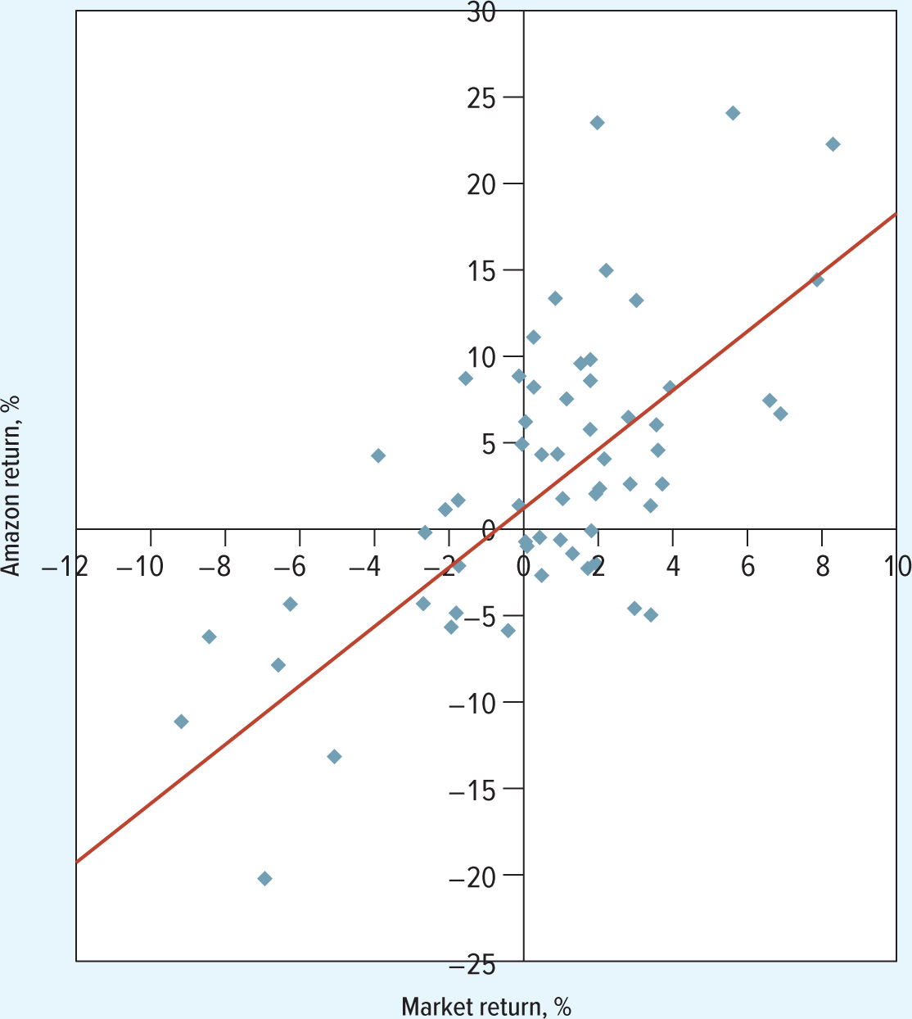
The Return on Amazon Stock
The return on Amazon stock changes on average by 1.55% for each 1.00% change in the market return. Beta is therefore 1.55.
6

Slide 7
Estimated Betas for Select U.S. Stocks.
Stock | Beta (β)
United States Steel | 2.98
Southwest Airlines | 1.58
Amazon | 1.55
Wells Fargo | 1.14
ExxonMobil | 1.14
Johnson & Johnson | 0.75
Tesla | 0.50
Coca-Cola | 0.46
Consolidated Edison | 0.31
Newmont | 0.16
7

Slide 8
Portfolio Risk, Beta 1
Calculating the variance of the market returns and the covariance between the returns on the market and those of Anchovy Queen. Beta is the ratio of
the variance to the covariance
(1) | (2) | (3) | (4) | (5) | (6) | (7)
Month | Market Return | Company Return | Deviation from Average Market Return | Deviation from Average Company Return | Squared Deviation from Average Market Return (Columns 4×4) | Product of Deviations from Average Returns (Columns 4×5)
1 | −8% | −11% | −10 | −10 | 100 | 130
2 | 4 | 8 | 2 | 6 | 4 | 12
3 | 12 | 19 | 10 | 17 | 100 | 170
4 | −6 | −13 | −8 | −15 | 64 | 120
5 | 2 | 3 | 0 | 1 | 0 | 0
6 | 8 | 6 | 6 | 4 | 36 | 24
Average | 2 | 2 |  | Total | 304 | 456
8

Slide 9
Portfolio Risk, Beta 2
9

Slide 10
Why Betas Determine Portfolio Risk
Risk in a well-diversified portfolio is given by its market risk.
Market Risk is measured by beta.
10

Slide 11
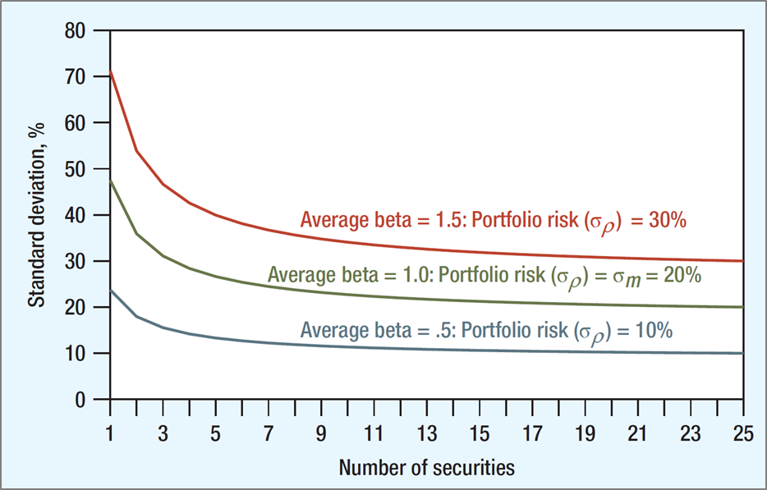
Portfolio Risk, Beta
The beta of a portfolio is the weighted average of the betas of the individual stocks within that portfolio.
Green line: Well-diversified portfolio of randomly selected stocks with
= 20% (market risk).
Red line: Well-diversified portfolio with
(1.5 times market risk).
Blue line: Well-diversified portfolio with
(half that of the market).
11

Slide 12



Capital Asset Pricing Model : The relationship between Risk and Return
How much extra return should an investor expect for bearing market risk.
An investor should only be rewarded for bearing a stock’s market risk, because only this risk can’t be gotten rid of through diversification.
$$r_{p}=r_{f}+\frac{r_{M}−r_{f}}{σ_{M}}σ_{p}$$
$$r_{i}=r_{f}+\frac{r_{M}−r_{f}}{σ_{M}}(market risk of stock i)$$
$$r_{i}=r_{f}+\frac{r_{M}−r_{f}}{σ_{M}}(β_{i}σ_{M})$$
12

Slide 13
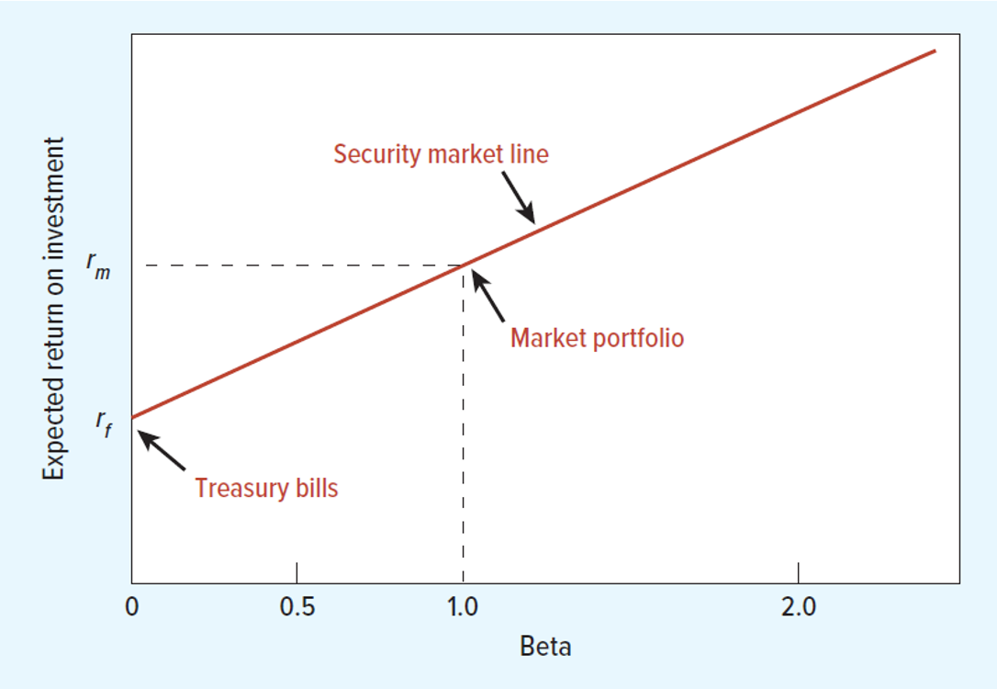
Capital Asset Pricing Model
CAPM states that the expected risk premium on each investment is proportional to its beta.
This means that each investment should lie on the sloping security market line connecting Treasury bills and the market portfolio.
13

Slide 14
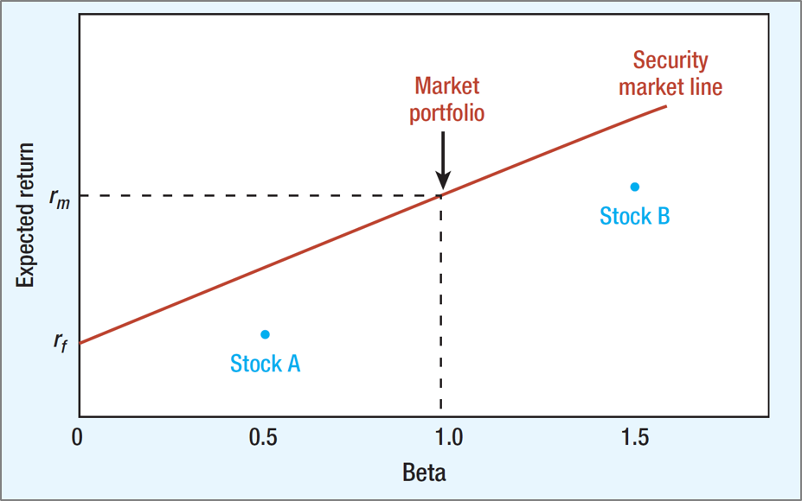
Equilibrium
In equilibrium, no stock lies below the security market line. Instead of buying Stock A, investors lend part of their money and put the balance in the market portfolio. Instead of buying Stock B, they borrow and invest in the market portfolio.
14

Slide 15
Expected Returns
These estimates of the returns expected by investors in December 2020 were based
on the C A P M. We assumed
and 7% for the expected risk premium,
Stock | Beta (β) | Expected Return
United States Steel | 2.98 | 22.9
Southwest Airlines | 1.58 | 13.0
Amazon | 1.55 | 12.8
Wells Fargo | 1.14 | 10.0
ExxonMobil | 1.14 | 10.0
Johnson & Johnson | 0.75 | 7.3
Tesla | 0.50 | 5.5
Coca-Cola | 0.46 | 5.2
Consolidated Edison | 0.31 | 4.1
Newmont | 0.16 | 3.1
15

Slide 16
Does C A P M Hold in the Real World 1
The C A P M makes several assumptions:
Investors choose portfolios based on expected return and variance (risk).
All investors have the same estimates of mean returns, variances, and covariances.
Investors trade in perfect capital markets.
no Taxes.
no Transaction Costs.
no restrictions on Short Sales.
can borrow and Lend at the same risk-free rate.
16

Slide 17
Does C A P M Hold in the Real World 2
Investors are price takers.
The supply of all assets is fixed.
17

Slide 18
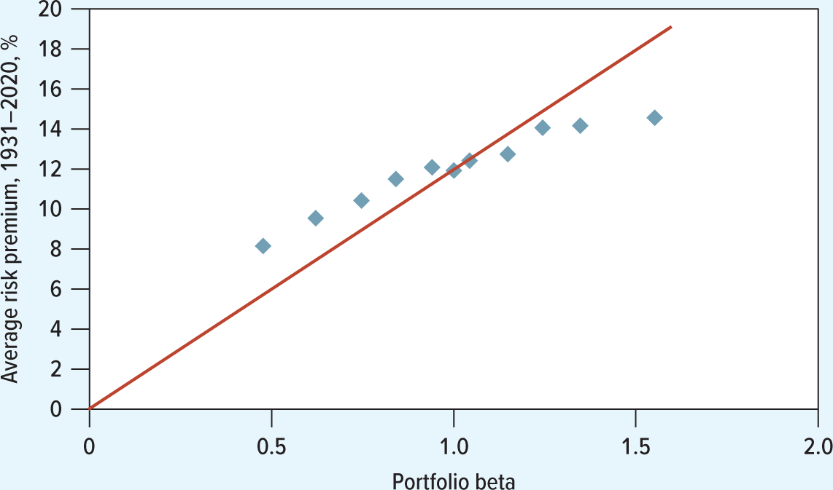
C A P M (19 31–2020)
Beta Versus Average Risk Premium.
18

Slide 19
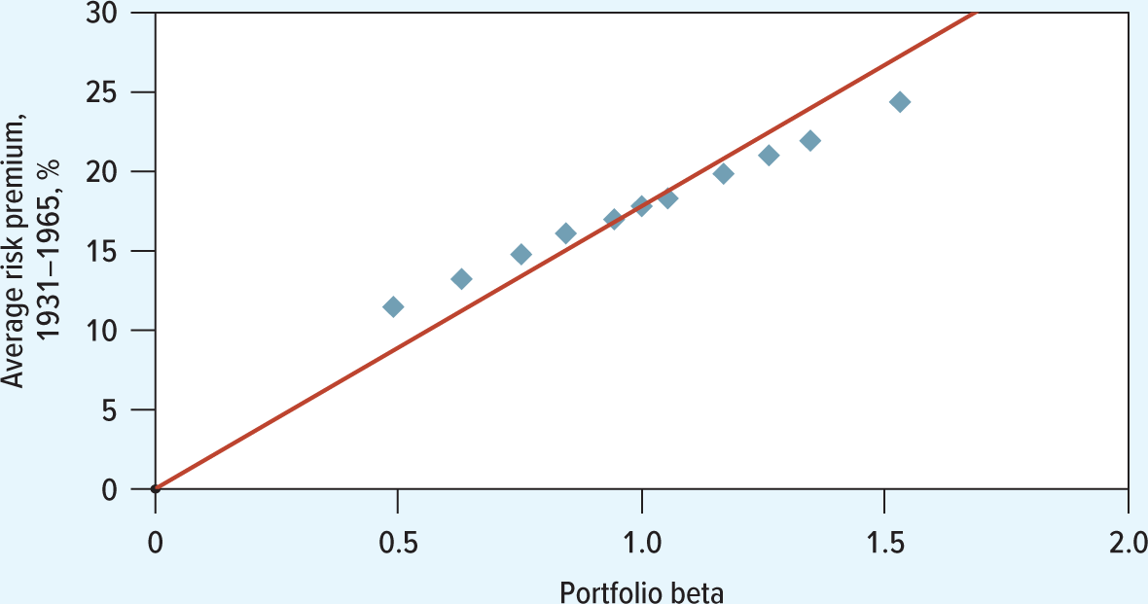
Relationship Between Beta and Average Return (mid-19 60s)
19

Slide 20
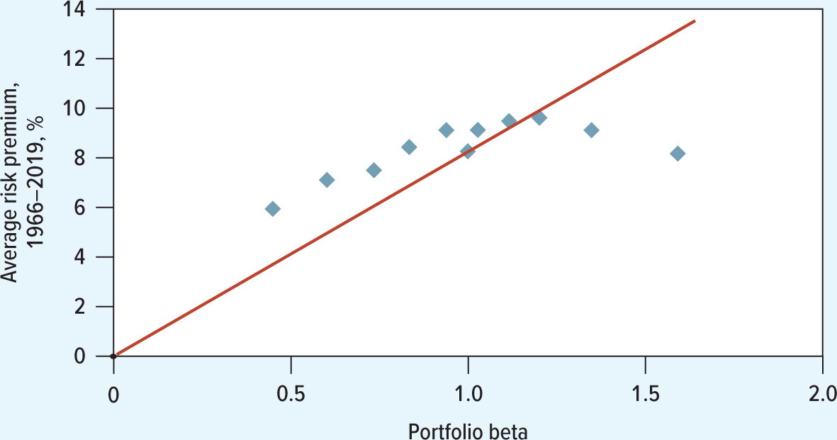
Relationship Between Beta and Average Return (19 66–2020)
Source: F. Black, “Beta and Return,” Journal of Portfolio Management 20 (Fall 19 93), pp. 8–18. Updates courtesy of Adam Kolasinski.
20

